Slide 1

Servers & Request

Slide 2
Client / Server
The server component of the client/server model has the responsibility of processing requests from multiple clients and maintaining the integrity of the data stored in the database on the server.

Slide 3
Objectives
Definition of terms
List advantages of client/server architecture
Explain three application components: presentation, processing, and storage
Suggest partitioning possibilities
Distinguish between file server, database server, 3-tier, and n-tier approaches
Describe and discuss middleware
Explain query-by-example (QBE)
Explain database linking via ODBC and JDBC
Explain VBA and Microsoft Access

Slide 4
Parallel Computer Architectures
Tightly Coupled
Symmetric Multiprocessing (SMP)
Multiple CPUs
Shared RAM
Loosely Coupled
Massively Parallel Processing (MPP)
Multiple CPUs
Each CPU has its own RAM space

Slide 5
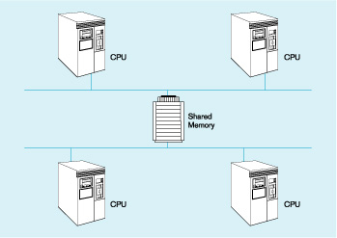
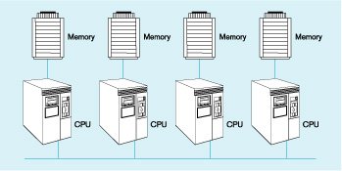
Parallel Computer Architectures
Tightly coupled – CPUs share common memory space
Loosely coupled – CPUs each have their own memory space

Slide 6
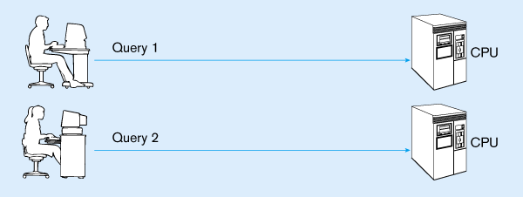
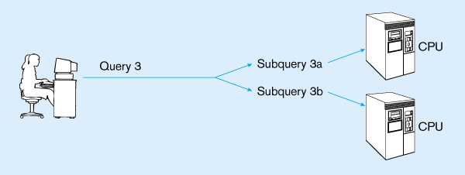
Query Processing with Parallel Processors
Parallel transactions
Parallel query

Slide 7
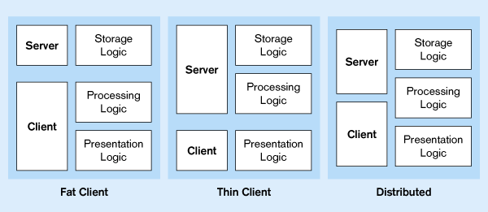
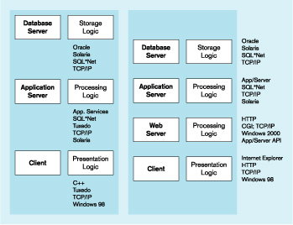
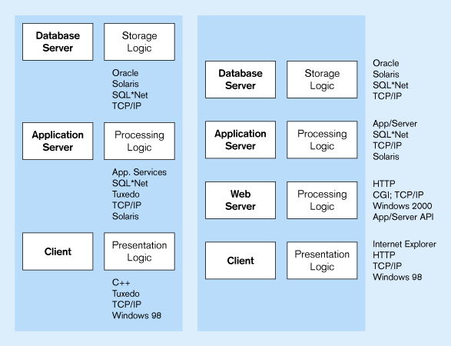
Processing Logic Distributions
Two-tier distributions
Processing logic could be at client, server, or both
Processing logic will be at application server or Web server
n-tier distributions

Slide 8
Middleware
Software which allows an application to interoperate with other software
No need for programmer/user to understand internal processing
Accomplished via Application Program Interface (API)
The “glue” that holds client/server applications together

Slide 9
Types of Middleware
Remote Procedure Calls (RPC)
client makes calls to procedures running on remote computers
synchronous and asynchronous
Message-Oriented Middleware (MOM)
asynchronous calls between the client via message queues
Publish/Subscribe
push technology → server sends information to client when available
Object Request Broker (ORB)
object-oriented management of communications between clients and servers
SQL-oriented Data Access
middleware between applications and database servers

Slide 10
Database Middleware
ODBC – Open Database Connectivity
Most DB vendors support this
OLE-DB
Microsoft enhancement of ODBC
JDBC – Java Database Connectivity
Special Java classes that allow Java applications/applets to connect to databases

Slide 11
Client/Server Security
Network environment ➔ complex security issues
Security levels:
System-level password security
for allowing access to the system
Database-level password security
for determining access privileges to tables; read/update/insert/delete privileges
Secure client/server communication
via encryption

Slide 12
Query-by-Example (QBE)
Direct-manipulation database language
Graphical approach
Available in MS Access
MS Access translates QBE to SQL and vice versa
Useful for end-user database programming
Good for ad hoc processing and prototyping

Slide 13
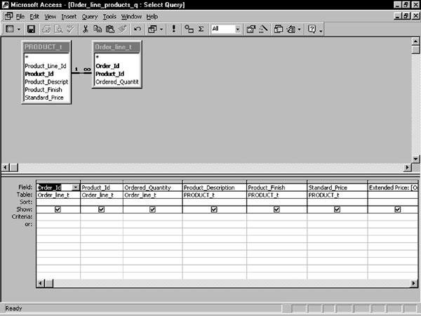
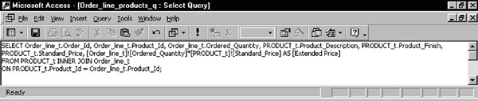
QBE view of a multiple-table join query
Equivalent query in SQL

Slide 14
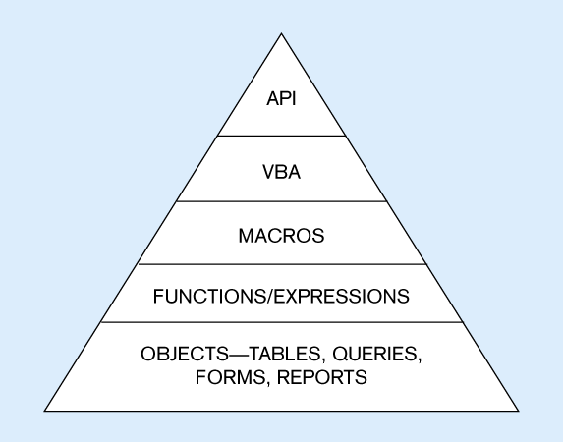
Access usability hierarchy
API to call functions in DLLs external to MS Access
Visual Basic for Applications…language for customizing the application
Stored modules of pre-existing VBA code
Simple processes
Foundation of MS Access

Slide 15
Using ODBC to Link External Databases Stored on a Database Server
Open Database Connectivity (ODBC)
API that provides a common language for application programs to access and process SQL databases independent of the particular RDBMS that is accessed
Required parameters:
ODBC driver
Back-end server name
Database name
User id and password
Additional information:
Data source name (DSN)
Windows client computer name
Client application program’s executable name
Java Database Connectivity (JDBC) is similar to ODBC – built specifically for Java applications

Slide 16
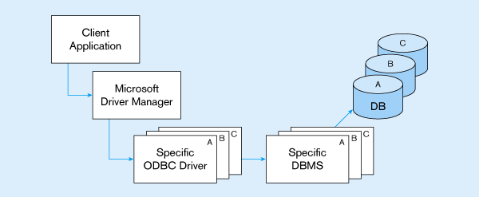
ODBC Architecture
Client does not need to know anything about the DBMS
Application Program Interface (API) provides common interface to all DBMSs
Each DBMS has its own ODBC-compliant driver

Slide 17
Client/Server Systems
Networked computing model
Processes distributed between clients and servers
Client – Workstation (usually a PC) that requests and uses a service
Server – Computer (PC/mini/mainframe) that provides a service
For DBMS, server is a database server

Slide 18
Application Logic in C/S Systems
Presentation Logic
Input – keyboard/mouse
Output – monitor/printer
GUI Interface
Processing Logic
I/O processing
Business rules
Data management
Procedures, functions,
programs
Storage Logic
Data storage/retrieval
DBMS activities

Slide 19
Client/Server Architectures
Client does extensive processing
File Server Architecture
Database Server Architecture
Three-tier Architecture
Client does little processing

Slide 20
File Server Architecture
All processing is done at the PC that requested the data
Entire files are transferred from the server to the client for processing
Problems:
Huge amount of data transfer on the network
Each client must contain full DBMS
Heavy resource demand on clients
Client DBMSs must recognize shared locks, integrity checks, etc.
FAT CLIENT

Slide 21
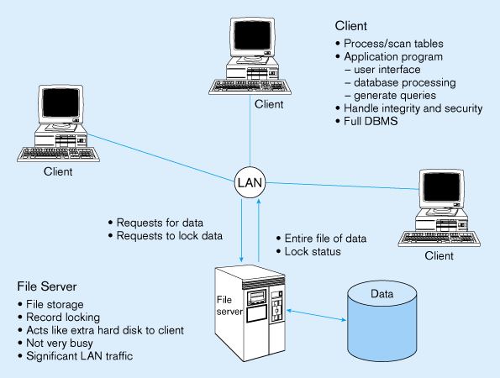
File Server Architecture
FAT CLIENT

Slide 22
Two-Tier Database Server Architectures
Client is responsible for
I/O processing logic
Some business rules logic
Server performs all data storage and access processing
➔ DBMS is only on server

Slide 23
Advantages of Two-Tier Approach
Clients do not have to be as powerful
Greatly reduces data traffic on the network
Improved data integrity since it is all processed centrally
Stored procedures ➔ some business rules done on server

Slide 24
Advantages of Stored Procedures
Compiled SQL statements
Reduced network traffic
Improved security
Improved data integrity
Thinner clients

Slide 25
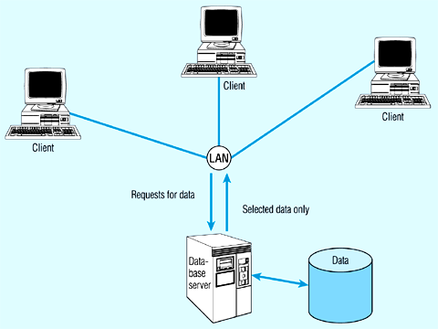
Two-tier database server architecture
Thinner clients
DBMS only on server

Slide 26
Three-Tier Architectures
Client
GUI interface
(I/O processing)
Browser
Application server
Web Server
Business rules
Database server
Data storage
DBMS
Thin Client
PC just for user interface and a little application processing. Limited or no data storage (sometimes no hard drive)

Slide 27
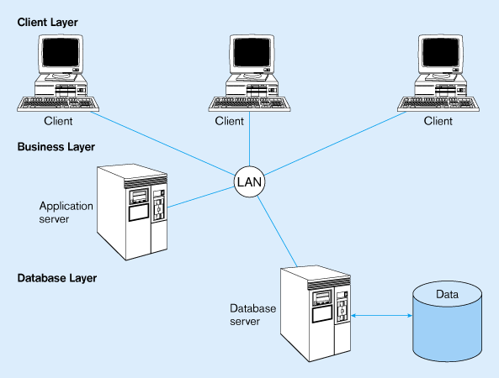
Three-tier architecture
Thinnest clients
Business rules on separate server
DBMS only on DB server

Slide 28
Advantages of Three-Tier Architectures
Scalability
Technological flexibility
Long-term cost reduction
Better match of systems to business needs
Improved customer service
Competitive advantage
Reduced risk

Slide 29
Challenges of Three-tier Architectures
High short-term costs
Tools and training
Experience
Incompatible standards
Lack of compatible end-user tools

Slide 30
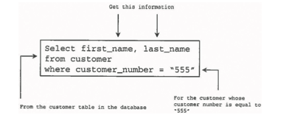
A request from a client is constructed of SQL statements, which are stored in a The file is transferred to the server component for processing.
Database management software on the server reads and follows the directions of the SQL state-ments in the request.
.

Slide 31
Client / Server Database
A database management system is designed to respond to multiple requests within a reasonable time frame, but requests can be delayed because the server component of the client/server model is the central point for requests. It can become a bottleneck on the network. If two requests require the same resources (i.e., data), the second request must wait until the first is processed.

Slide 32
Databases History
The first databases were stored on large centralized mainframe computers that users accessed from terminals
As distributed computing and microcomputers became popular during the 1980s, two knew kinds of databases emerged: personal databases and client/server databases.

Slide 33
Personal Databases
Personal database systems, such as Microsoft Access and FoxPro, are aimed toward single-user database applications that usually are stored on a single user’s desktop computer, or a client workstation.
When a personal DBMS is used for multi-user application, the database application files are stored on a file server and transmitted to the individual users across the network.

Slide 34
Personal Databases
With a personal DBMS, each client workstation must load the entire database application into main memory along with the client database application in order to view, insert, update, or print data.
Recent personal databases use indexed files that enable the server to send only part of the DB, but in either case, these DBMSs put a heavy demand on client workstations and on the network.

Slide 35
Client/Server Databases
In contrast client/server databases, such as Oracle, split the DBMS and the applications accessing the DBMS into a “process” running on the server and the “applications running” on the client.
The client application sends data requests across the network. When the server receives a request, the server DBMS process retrieves the data from the database, performs the requested functions on the data (sorting, filtering, etc) and sends only the final query result (not the entire database) back via the network to the client.

Slide 36
Personal vs. Client/Server
Multi-user client/server databases generate less network traffic than personal database.
Handle client failures: In a personal database system, when a client workstation fails, the DB is likely to become damaged due to interrupted updates, insertions or deletions. Records in use at that time of the failure are locked by failed client, which means they are unavailable to other users.

Slide 37
Personal vs. Client/Server
On the other hand, a client/server database is not affected when a client workstation fails. The failed client’s in-progress transactions are lost, but the failure of a single client does not affect other users.
In the case of a server failure, a central synchronized transaction log, which contains a record of all current database changes, enables in-progress transactions from all clients to be either fully completed or rolled back.

Slide 38
Personal vs. Client/Server
Handle competing user transactions: In a client/server system the transaction causes the database to read the table and simultaneously lock all or part of the table prior to updating the table.
A personal database, uses optimistic locking: it hopes that two competing transactions will not access the same record at the same time. Optimistic locking, therefore, does not really lock the table. Access will notify the user that the table has been changed since he or she last read it, but then Access offers to proceed and save the update anyway

Slide 39
The Oracle 10g Client/Server Database
Oracle 10g
Latest release of Oracle Corporation’s relational database
Client/server database
Server side
DBMS server process
Oracle Net
Utility that enables network communication between client and server

Slide 40
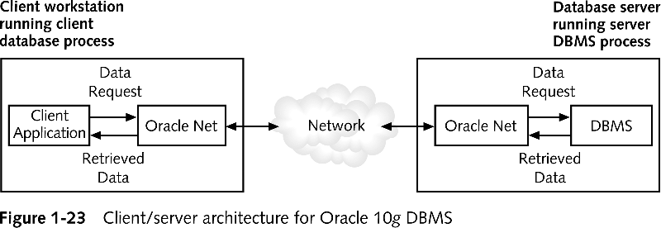
Client/Server Architecture for Oracle 10g DBMS

Slide 41
The Oracle 10g Client/Server Database (continued)
Oracle Application Server
Used to create World Wide Web pages that allow users to access Oracle databases
Oracle client products:
SQL*Plus
Oracle 10g Developer Suite
Forms Builder
reports Builder
Enterprise Manager

Slide 42
Summary
Are subject to a lot more errors than guided media channels.
Interference is one cause for errors, can be circumvented with high SNR.
The higher the SNR the less capacity is available for transmission due to the broadcast nature of the channel.
Channel also subject to fading and no coverage holes.

